Slide 1

Media Streaming with Cloud
Learn about the latest trends and innovations in cloud-based media streaming and why it's transforming the industry.

Slide 2
Benefits of Cloud Media Streaming
Scalability
Cost-effective
Cloud storage can accommodate rapid and large-scale growth of data, giving companies more space to store high-quality media content.
Media streaming on the cloud is cost-efficient as it eliminates the need for additional hardware and infrastructure, especially for businesses that need to store a vast amount of data.
Improved Access
Global Reach
Users can access their media content anytime from anywhere in the world using cloud-based streaming services.
Cloud streaming services have a vast network of servers worldwide that ensures smooth streaming and quick access to the media content.

Slide 3
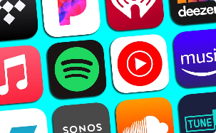

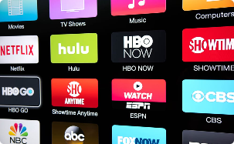

Types of Cloud-based Media Streaming
Music Streaming
Live Streaming
Video Streaming
Cloud-based music streaming services like Spotify and Apple Music offer a vast collection of music tracks that can be accessed globally.
Cloud-based live streaming is widely used in sports, news, and entertainment industries due to its scalability and ease of access.
Cloud-based video streaming services like Netflix, Amazon Prime Video, and Hulu have revolutionized the way we watch movies and TV shows.
Cloud Gaming
Cloud gaming is the future of interactive gaming that offers high-quality and immersive gaming experience without the need for high-end computing devices.

Slide 4
Challenges and Solutions in Cloud-based Media Streaming
1
Latency Issues
Latency is one of the significant challenges in cloud-based media streaming. Progressive Web Applications (PWA) and Content Delivery Networks (CDN) provide low latency streaming solutions.
Security Concerns
2
Cloud-based media streaming raises concerns about data privacy and security. Advanced encryption techniques, including HTTPS, SSL, and DRM, provides advanced security features.
3
Network Congestion
During peak network traffic times, network congestion can cause buffering and slow streaming speeds. CDN and robust network infrastructure can solve network congestion issues.

Slide 5

Leading Cloud Streaming Services in the Market
Amazon Web Services (AWS)
Microsoft Azure
Google Cloud Platform
IBM Cloud
Rackspace

Slide 6



Case Studies of Successful Implementation
Netflix
Spotify
Hulu
Netflix is a prime example of a cloud-based media streaming success story. The company has revolutionized the media streaming industry by relying on its robust cloud infrastructure.
The popular music streaming service has experienced massive success from its cloud-based media streaming approach by delivering high-quality music content to millions of subscribers worldwide.
The US-based streaming service provides cloud-based access to movies and TV shows on various devices. Hulu leverages the cloud to avoid scalability issues and ensures high-level user experience.

Slide 7

Future Trends and Opportunities in Cloud Media Streaming
1
Edge Computing
2
5G and AI
Edge computing will have a significant impact on the media streaming industry by reducing latency and improving streaming performances.
5G and AI will further improve media streaming performances and provide more opportunities for cloud-based media streaming innovation.
3
IoT Integration
IoT devices integration with cloud-based media streaming services will enable seamless access to media content from multiple devices.

